Slide 1
The role of context and perspective in conditional sentences

Slide 2
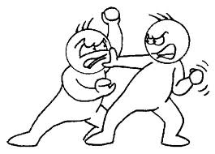
Let’s think what is happening in this story excerpt:
James: “You mean to say, it wasn’t you who got rid of him?”
Will: “Of course not… I’d offered the jerk two hundred dollars to go back where he came from. If I hadn’t been ill, I would have gotten him away all right and that’s what I thought you had done.
James: “Forgive me, Will – I thought you’d done him in… but I didn’t blame you. Only I wished that it had happened in a fair fight.”
Will: “If it had happened, Jim, it would have been in a fair fight. I might have killed him, but I wouldn’t have killed him when he was tied up.”

Slide 3
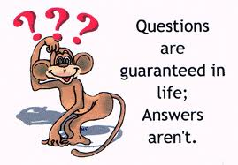
Carrie Bradshaw said:
“As we drive along this road called life, occasionally a gal will find herself a little lost. And when that happens, I guess she has to let go of the coulda, shoulda, woulda, buckle up and just keep going.”
What does “coulda, shoulda, woulda” (=could have, should have, would have) mean here?

Slide 4

What does the speaker see looking from here?

Slide 5

What about from here?

Slide 6
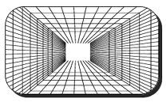
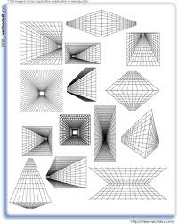
What are possible differences?
Point of view (original position of viewer)
Range of outlook (broad vs. narrow, constrained vs. unconstrained)
Limits to the view (present or absent)
Dynamic vs. static view

Slide 7
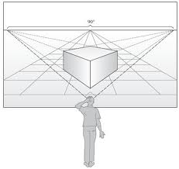
Perspective
Perspective exists in language, too
So how is it expressed through language?

Slide 8
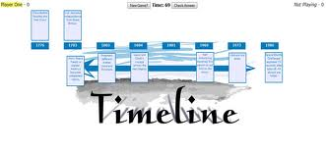
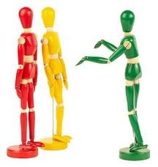

Perspective through language
  Reference to time (tense): how far is it within the zone of control?
  Personal reference (you vs. they, she vs. you, etc): whether speaker puts himself together or apart with the rest of context
  Spatial location: here vs. there

Slide 9
In conditional sentences
Here and now, I/my world, within zone of control ➔ present and future tense
Then and there, he/she/it/they, outside of zone of control ➔ past perfect + would have been

Slide 10

Look at the following excerpt from an article on problems with racial patterns in dating in the English-speaking world (excerpt taken from the Guardian):

Slide 11
The so-called relationship experts bulldoze the individual nature of the mating game in the rush to diagnose millions of people with the same problem. The truth is, there are many reasons why people find themselves single. Sometimes, it's their own attitudes. But many other times, the timing just isn't right, their careers are too demanding, or they need to focus elsewhere. As a black woman who has been in a committed relationship for five years, nothing is more obvious to me than how random circumstance plays a major role in many happy relationships. If I hadn't missed a concert, I wouldn't know my boyfriend; if one of my friends hadn't gone to Mali with the Peace Corps, she would have never been on the same continent as her now-husband; if another friend hadn't missed her original train and hadn't been wearing a sweatshirt from her alma mater, she would have never met the man she would marry.

Slide 12
What’s happening here?
Current situation for speaker: I’m here and now;
Scenarios from the past that cannot be changed anymore and that are brought as rhetorical examples: speaker uses “past perfect + would have been” to signal those;
Double-removed from zone of control to show lack of relevance of such examples for now

Slide 13
Two parts
The so-called relationship experts bulldoze the individual nature of the mating game in the rush to diagnose millions of people with the same problem. The truth is, there are many reasons why people find themselves single. Sometimes, it's their own attitudes. But many other times, the timing just isn't right, their careers are too demanding, or they need to focus elsewhere. As a black woman who has been in a committed relationship for five years, nothing is more obvious to me than how random circumstance plays a major role in many happy relationships. If I hadn't missed a concert, I wouldn't know my boyfriend; if one of my friends hadn't gone to Mali with the Peace Corps, she would have never been on the same continent as her now-husband; if another friend hadn't missed her original train and hadn't been wearing a sweatshirt from her alma mater, she would have never met the man she would marry.

Slide 14
Strategies for you to keep in mind
Look around and check where the speaker may be coming from, as far as his/her perspective is concerned.
Is the event taking place in the same moment of speech, or is it removed from the moment of speech, i.e. located outside of zone of control?

Slide 15
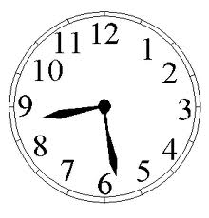


Contrast between if and when
1) it will happen:
When she awakens, she will think a magician has been there.
2) it’s uncertain that it will happen:
If she awakens, she will think a magician has been there.

Slide 16
Type of prediction
When: is negative prediction possible?
If: is negative prediction possible?

Slide 17
Type of prediction
When: negative prediction is NOT possible
If: negative prediction IS possible

Slide 18

Tenses
Had I been him, I would have thrown me out, but he said no, sure he’d talk, he’d be happy to, if I didn’t mind.

Slide 19
Questions to discuss
How many speakers are in this sentence? How many characters are there?
Where does the speaker place himself? Is he in the here and now zone or in the removed zone (there and then)? How far removed is he?
How does the speaker mark it through language?

Slide 20
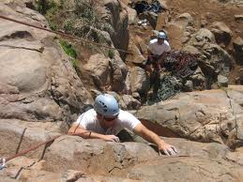
Role of adjacent tenses
How I came to be clinging to a steep slope of ice-cold, muddy soup, bleeding, alone, and off-trail in Glacier National Park is a long story, so I'll spare you the details. It was the kind of thing you don't want to tell even your friends, an embarrassment of huge proportions. I was in over my head on my first day out and I was contemplating the unimaginable - giving up. Oh, die shame! It will not be so bad if I am not obsessed about this hike for so long. For months, a photo of Sperry Glacier - the precise spot where I ran into trouble - had gleamed at me from my computer screen. From the comfort of my office chair, I studied every detail of the cross-country Floral Park route, and chatted with online advisers who assured me that it was a piece of cake.

Slide 21
‘If’ and other sentences
Is the speaker the same as the character?
Is he located inside or outside of zone of control?
How does he use tenses to signal that?
Does the sentence in red fit with the rest of the context and tenses? Why or why not?

Slide 22
Role of adjacent tenses
How I came to be clinging to a steep slope of ice-cold, muddy soup, bleeding, alone, and off-trail in Glacier National Park is a long story, so I'll spare you the details. It was the kind of thing you don't want to tell even your friends, an embarrassment of huge proportions. I was in over my head on my first day out and I was contemplating the unimaginable - giving up. Oh, die shame! It would not have been so bad if I had not been obsessed about this hike for so long. For months, a photo of Sperry Glacier - the precise spot where I ran into trouble - had gleamed at me from my computer screen. From the comfort of my office chair, I studied every detail of the cross-country Floral Park route, and chatted with online advisers who assured me that it was a piece of cake.

Slide 23
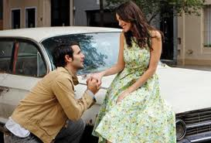
Proposal: yes or no?
John Riley planned to propose to Eboni Marshall, he was shocked to discover that the restaurant where he wanted to do it -- Asiate in the Mandarin Oriental Hotel -- had booked him for the following Saturday. He made frantic calls to the restaurant and was told he would be called back if they could accommodate him. He told his hoped-to-be-fiancee about the confusion as they were driving down Columbus Avenue toward Asiate. Knowing nothing of the proposal, she tried to assure him that pizza or McDonald's would do. At that, Mr. Turman said, he shouted ‘no’ and, taking her hand, began to pray.

Slide 24
Questions to discuss
What’s the time of the situation?
Is the speaker the same as character?
Are events portrayed as concurrent (happening at the same time as moment of speech) or removed?
What language tools should we use to convey this?

Slide 25

References to time
Let's Make A Deal: SELLERS may be able to reduce the broker's commission. Here are some strategies:
# Interview several agents before signing a listing agreement, and ask if they had accepted less than 6 percent.
# If the buyer had not had an agent, negotiate a reduced commission -- for instance 5 percent.
# Engage the same agent to sell your current home and to buy your next one.
# Choose an agency that offers fewer services and do some -- or most -- of the work yourself.
# Use an independent agent who does not have to split commissions with a large company.

Slide 26
Follow-up
How does this sentence fit into the discourse context?
What is the perspective of the speaker/narrator?
Would you change the sentences in red and if so, how?

Slide 27
Bottom line: cues to look for
Tenses in surrounding sentences
Perspective of speaker who is narrating: is it the same as character? Is s/he still within the zone of control or already outside it?
Time markers such as adverbs, adjectives, etc. providing an idea of what time is referenced
Appropriateness of forms for discourse context

Slide 28
Tasks
Text repair task
Seating chart task

