Slide 1
If: expressing different scenarios through language
Part 2: Role of tenses in conditional constructions

Slide 2
Flowchart
Based on your understanding of context needs, which tense would work best for the if-clause?
Based on your understanding of context needs, which tense would work best for the main-clause?

Slide 3
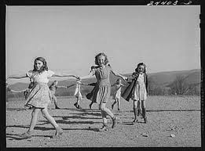
Let’s think about how time organizes our lives: how can you characterize this picture?

Slide 4
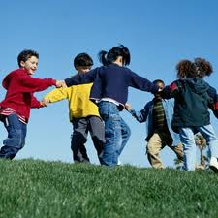
What about this video:
http://www.youtube.com/watch?v=okcROjJ7F_I&feature=related

Slide 5
Time
Past
Present
Remote
Cannot be touched or accessed through other sense → unclear or uncertain
Outcomes CANNOT be affected
In other words, speaker has NO CONTROL over it
Here and now
Can be accessed through senses → easily identifiable
Outcomes CAN be affected
Speaker HAS CONTROL over it

Slide 6
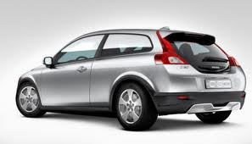
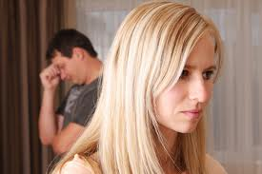
What is the difference between these examples?
A: Phil is thinking about getting a Volvo
B: Sarah has a Volvo.
A: you have got to stop talking about Sarah as if you’re still together.

Slide 7
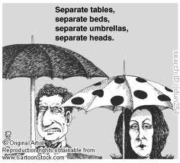
What is the difference between these examples?
A: Phil is thinking about getting a Volvo
B: Sarah had a Volvo.
A: Out of sight, out of mind!

Slide 8

Let’s look at a few more examples together
I wish I knew what he’d say next.
I wish the students liked phonetics.
Supposed your house burned down. Do you have insurance?
I was thinking about asking you to dinner.
My first husband was Italian (he is still alive).

Slide 9
Role of present tense
ZONE OF NO CONTROL
USE PRESENT OR FUTURE
ZONE OF CONTROL
THEN
NOW

Slide 10
Role of past tense
ZONE OF NO CONTROL
USE PAST TENSES (SIMPLE, PROGRESSIVE, OR PERFECT)
ZONE OF CONTROL
THEN
NOW

Slide 11

How does this work in conditional sentences
Hypothetical scenario signals what is considered to possible and impossible, can be affected or cannot be affected:
  Distance = lack of control → past tenses

Slide 12

How does this work in conditional sentences
Hypothetical scenario signals what is considered to possible and impossible, can be affected or cannot be affected:
  Closeness = potential for control → present and future tenses

Slide 13
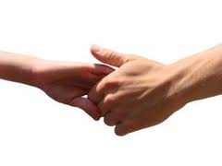
Pairing of verb forms
Some verb forms traditionally go hand in hand (or collocate) with each other
Such pairings are:
  Meaningful
  Reflect what the background knowledge of the speaker is
  Reflect whether speaker considers present possible or impossible

Slide 14
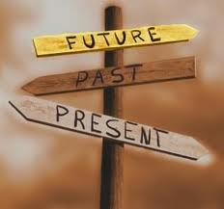
Typical tense pairings: present and future
Simple-present-tense form is standardly used to express future time reference in the if-clause
In if-clause, the focus is being shifted back to signal greater degree of possible effect onto future results
In contrast, main clauses usually have will future verb forms for with future reference.

Slide 15
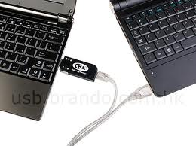
Which one is more standard?
If Amy takes the card, then the data will be transferred to his computer
If Amy will take the card, then the data will be transferred to his computer

Slide 16
Which one is more standard?
If Amy takes the card, then the data will be transferred to his computer
If Amy will take the card, then the data will be transferred to his computer

Slide 17

In a nutshell:
If-clause: present tense indicates that current situation is still in the ZONE of CONTROL
Main clause: future indicates future situation, which is a possible outcome of the PRESENT (that, again, can STILL be controlled)

Slide 18
Typical tense pairings: past and would + infinitive
If-clause: → use past (simple) tense
  Why?
  Basis for prediction (i.e., if-clause) – implausible
  CURRENT situation cannot be affected at this point, i.e. it is located OUTSIDE of ZONE of CONTROL
  Past tense in if-clause signals that situation is represented in a way that is DIFFERENT from what can be observed in the present

Slide 19
Typical tense pairings: past and would + infinitive
Main clause: would + infinitive
Why:
Would reflects impossible outcome and signals an alternative, CURRENTLY IMPROBABLE reality
Speaker’s stance is negative → tense does not reflect closer “involvement” with reality → use of infinitive (verb form without time reference)

Slide 20
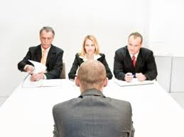
Which one is more standard?
If he decided to file the suit, the hospital’s lawyers would be allowed to interview him for discovery.
If he decided to file the suit, the hospital lawyers will be allowed to interview him for discovery.

Slide 21
Which one is more standard?
If he decided to file the suit, the hospital’s lawyers would be allowed to interview him for discovery.
If he decided to file the suit, the hospital lawyers will be allowed to interview him for discovery.

Slide 22
Typical tense pairings: past perfect and would + have + past participle
What is happening:
Key focus: NEGATE NOW
Create a space where you can talk about remote situations
Produce a hypothetical judgment about a time and space completely OUTSIDE the ZONE of CONTROL

Slide 23
Typical tense pairings: past perfect and would + have + past participle
If-clause: → use past perfect tense
  Why?
  Basis for prediction (i.e., if-clause) – implausible
  PAST situation cannot be affected, i.e. it is located OUTSIDE of ZONE of CONTROL and IN THE PAST
  Past perfect tense in if-clause signals DOUBLE level of distance from what can be observed in the present → double level of grammatical marking

Slide 24
Typical tense pairings: past perfect and would + have + past participle
Main clause: use would + have + past participle
Why:
Would have reflects impossible outcome and signals an alternative, CURRENTLY IMPROBABLE reality
Speaker has removed him-/herself from the space of IMPROBABLE REALITY and presents another, more removed level of hypothesizing

Slide 25
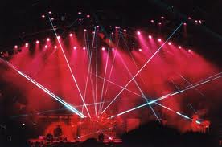
Which one is more standard and why?
If you had helped me out, I would have given you tickets to the show.
If you had helped me out, I would give you tickets to the show.

Slide 26
Which one is more standard and why?
If you had helped me out, I would have given you tickets to the show.
If you had helped me out, I would give you tickets to the show.

Slide 27
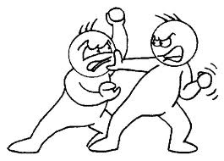
Let’s think what is happening in this story excerpt:
James: “You mean to say, it wasn’t you who got rid of him?”
Will: “Of course not… I’d offered the jerk two hundred dollars to go back where he came from. If I hadn’t been ill, I would have gotten him away all right and that’s what I thought you had done.
James: “Forgive me, Will – I thought you’d done him in… but I didn’t blame you. Only I wished that it had happened in a fair fight.”
Will: “If it had happened, Jim, it would have been in a fair fight. I might have killed him, but I wouldn’t have killed him when he was tied up.”

Slide 28
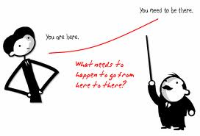

Slide 29

Avatar
http://www.youtube.com/watch?v=1QEFrI-D_3c&feature=related

Slide 30
Questions to consider:
How would we as viewers treat the reality represented in the movie: it is in the zone of control, outside of zone of control, or twice removed from zone of control?
What tense would we likely use to talk about this reality?
What would happen if…

Slide 31
Let’s practice
Avatar practice
Global warming task

