Slide 1
If: expressing different scenarios through language
Part 1: Speaker’s background knowledge

Slide 2
Things we will talk about
How language is organized
How conditional sentences are organized
What you should keep in mind when interpreting and making conditional sentences

Slide 3

Look at the puzzle: What does it make you think of?

Slide 4
If we were talking about language, we would say
Language works as a puzzle, as it consists of many parts that fit into one whole
Parts have to fit into each other, hence the need for grammar rules

Slide 5

What about this one?

Slide 6
Language assumptions to keep in mind
Different configurations of puzzle pieces, or language parts will signal different meanings
As a speaker, you have A LOT of choice as to how you put these parts together

Slide 7

Please keep these things in mind as we talk more about conditionals

Slide 8

But first let’s discuss:
In what situations do we require sentences that use if?
What do you find the most challenging about these if sentences?

Slide 9
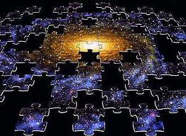
Big picture
Two key functions of if-sentences:
  Prediction
  Establishing cause-effect relations
We can use if-sentences to refer to current or future situations when we hypothesize about reasons for how things were, are, or will be in the future.

Slide 10
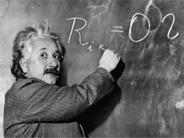
A little bit of theory
If – phrases: ‘proper’ term – conditional constructions
They portray different scenarios and outcomes of those scenarios
How can we signal different types of outcomes:
  Verb tense
  Time references (adverbs, adjectives, etc.)
  Context cues

Slide 11

What would have happened if Alice hadn’t seen the rabbit?
http://www.youtube.com/watch?v=3ppsDNkBLGY&feature=related
… she would have gotten married.
… she would not have fallen down the hole.
… she would have never found herself in Wonderland.

Slide 12
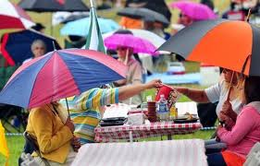

Look at these sentences
If it rains tomorrow, they’ll cancel the picnic.
If I had done my homework, I would have done better on the test.
What is the key purpose of these sentences?

Slide 13
two typical parts
The if-clause
If it rains tomorrow,
If I had done my homework,
The main clause
they’ll cancel the picnic.
I would have done better on the test.

Slide 14

Typical rules?
Turn to your partner and discuss:
  What are the rules you were taught about the use of conditionals?
  What are the things that you still find challenging about conditional phrases?

Slide 15
Components that create conditional meaning
We are going to look at conditionals in a somewhat different way than what you may be used to
We’ll start with discussing speaker’s assumptions and different language components that make up the core of conditional meaning.

Slide 16

Speaker’s reality
As a language speaker, you recreate the reality that *you* believe exists or is possible to exist.
To make judgment about whether or not certain outcomes are possible, you need to use corresponding language tools, pressing appropriate keys when they sound right.

Slide 17
Hypothetically speaking
Conditional sentences allow us to hypothesize about the present or the future.
Whenever we hypothesize, we think of more than one outcome.
Whenever we hypothesize, we have more than version of what is currently true and what is possible.

Slide 18
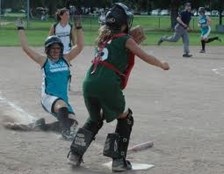
Think about alternative outcomes of:

Slide 19
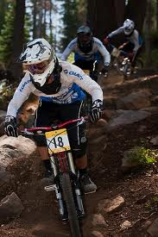
Think about alternative outcomes of:

Slide 20
Questions to keep in mind
Language codes different outcomes with different means;
You can adjust the linguistic means that you have available to match your desired message.

Slide 21
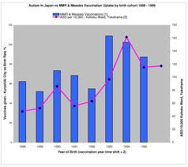
Read the following sentences
If Dan finds the necessary data, he will share it with us in class.
If Dan found the necessary data, he would share it with us in class.
How do they differ from each other?

Slide 22

Let’s look at these sentences more closely

Slide 23
If Dan finds the necessary data, he will share it with us in class.
What do we assume? Speaker’s background knowledge:
  Dan has access to the data
  It is not readily available → it needs to be found
  We believe it is indeed possible for Dan to find the data
  Since it is possible for the data to be found, we can make predictions about its use, i.e. share in class

Slide 24
So a picture of it will look like this:

Slide 25
If Dan finds the necessary data, he will share it with us in class.
Background knowledge/
Dan finds the data
Dan doesn’t find the data
He will share it with us in class
He won’t share it with us in class.
Dan has the data
It can be found
Likely scenario/ Realis
Unlikely scenario/ Alternative

Slide 26
Because we think the situation is realistic, which version of reality is being highlighted?
In other words, which version of reality is being brought to the foreground?

Slide 27
If Dan finds the necessary data, he will share it with us in class.
Background knowledge/
Dan finds the data
Dan doesn’t find the data
He will share it with us in class
He won’t share it with us in class.
Dan has the data
It can be found
Likely scenario
Unlikely scenario

Slide 28
If Dan finds the necessary data, he will share it with us in class.
Background knowledge/
Dan finds the data
He will share it with us in class
Dan has the data
It can be found
Likely scenario

Slide 29
Speaker’s stance, or attitude toward situation
Speaker believes that situation can still change
Speaker’s stance/attitude toward situation: neutral/positive
When we use if-clauses, language features that allowed the speaker to signal possible outcomes: present and future tense

Slide 30

So how is it different from the other one?

Slide 31
If Dan found the necessary data, he would share it with us in class.
Background knowledge:
  There is no evidence that Dan has found the necessary data yet

Slide 32
If Dan found the necessary data, he would share it with us in class.
Background knowledge/
Dan did not find the data
Dan found the data
It wasn’t shared with us in class
He shared it with us in class.
There is no evidence that Dan has found the data
Existing outcome
Alternative (currently non-existent) outcome

Slide 33
If Dan found the necessary data, he would share it with us in class.
Background knowledge/
Dan did not find the data
It wasn’t shared with us in class
There is no evidence that Dan has found the data
Existing outcome

Slide 34
Speaker’s stance, or attitude toward situation
Speaker believes that situation cannot change at this point
Speaker’s stance/attitude toward situation: negative
In if-clauses, language features that allowed the speaker to signal the negative outcome: past tense & would+infinitive (would= historical past tense)

Slide 35
We’ll try more next time

Slide 36
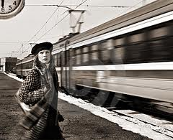
Let’s try again
If she misses the train, she will not meet her husband.
If she had missed the train, she would have not met her husband.

Slide 37
If she misses her train, she will not meet her husband
Background knowledge:
The train is coming in the near future
it is important to be on time to catch it

Slide 38
If she misses her train, she will not meet her husband.
Background knowledge/
It is possible for her to miss the train.
It is not possible for her to miss the train.
She will not meet her husband
She will meet her husband.
A train is coming.
One needs to be on time to catch it.
Possible outcome
Alternative outcome

Slide 39
A train is coming.
One needs to be on time to catch it.
It is possible for her to miss the train.
She will not meet her husband

Slide 40
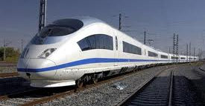
Let’s do this one together

Slide 41
If she had missed her train, she would have never met her husband
Background knowledge:
She did not miss the train

Slide 42
Summary:
If you believe or want to signal that the outcome can still change, you use present and future tense;
If you believe or want to signal that the outcome cannot be changed at this point, you use a combination of past tense(-s) and would.

Slide 43
Flowchart to help in process
Based on the context, do you think this is a realistic situation?
Look at the if-sentence. When did the action take place?
Look at the main clause. When did the action take place?

Slide 44
Flowchart
Based on your understanding of context needs, which tense would work best for the if-clause?
Based on your understanding of context needs, which tense would work best for the main-clause?

Slide 45
Flowchart
Now that you determined the tenses, does the sentence convey what you think it should be conveying?
Read the following sentence. Does the combination/sequence of tenses work well?

Slide 46
Flow chart: determine what is the background knowledge
Start with thinking about the background knowledge in question. What is realistic?
What is the possible or projected time of condition (if-clause)?
What is the possible or projected time of result (main clause)?
Pick the tenses that will reflect such an arrangement.
Check if your sentence makes sense overall.

Slide 47
Practice using flow chart
Speaker’s background knowledge task

